Slide 1



Task-specific Fine-tuning via Variational Information Bottleneck for Weakly-supervised Pathology Whole Slide Image Classification
Honglin Li , Chenglu Zhu , Yunlong Zhang , Yuxuan Sun , Zhongyi Shui , Wenwei Kuang , Sunyi Zheng, Lin Yang*
Published in: Conference on Computer Vision and Pattern Recognition (CVPR)（2023）
Saif Ur Rehman Khan
Notes:
这篇文章提出了一种强化学习(RL)智能体，强化因果解释器(RC-Explainer)，以实现因果筛选策略。

Slide 2
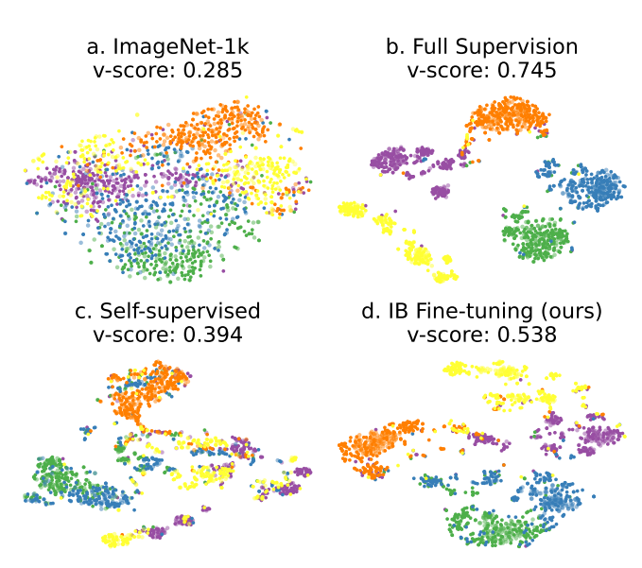
1
Introduction
Multiple Instance Learning
Popular in digital Pathology WSI
Robustness to tissue-level variations
Ability to handle weakly labeled data
MIL
High computational costs
Limited supervision
Loss of key information
Generalization Problems
Lack of exploration in SSL for downstream tasks
Figure 1. T-SNE visualization of different representations on patches. a. ImageNet-1k pretraining. b. Full patch supervision. c. Self-supervised Learning. d. Fine-tuning with WSI labels.
自强不息 厚德载物
Central South University
Notes:
Benefit of MIL
Robustness to tissue-level variations: Multiple Instance Learning (MIL) allows models to focus on regions of interest within whole slide images (WSIs), enabling robust analysis despite variations in tissue composition, staining, or image quality across different slides.
Ability to handle weakly labeled data: MIL is well-suited for scenarios where only slide-level labels are available, as it can learn from multiple instances (patches or regions) within each slide without requiring precise annotations for individual instances. This capability is particularly beneficial in digital pathology, where obtaining detailed annotations for every region of interest can be time-consuming and expensive.
Negative Points: High computational costs: MIL in digital pathology WSI analysis requires significant computational resources due to the large size of gigapixel WSIs.
Limited supervision: Gigapixel WSIs often lack detailed annotations or labels, leading to limited supervision for training models.
Loss of key information: Utilizing a frozen model pretrained from ImageNet may result in the loss of crucial information due to domain gaps between natural images and pathology images.
Hindrance to generalization: Pretraining on ImageNet without specific task-related training-time augmentation may hinder the model's ability to generalize well to digital pathology WSIs.
Lack of exploration in SSL for downstream tasks: While SSL offers promising representation learning schemes, there is a lack of exploration in utilizing SSL for MIL in digital pathology WSI analysis, particularly in leveraging task-specific features through partial label tuning.
Figure 1: The differences among the feature representations are depicted in Figure 1, where the feature representation under full patch-level supervision is considered as the upper bound.

Slide 3
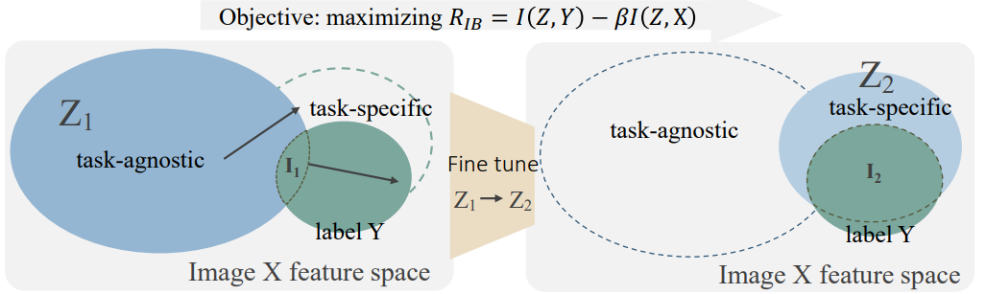
1
Former Approach Problems and Motivation
Previous MIL Approach Limitation
Previous methods in digital pathology whole slide image (WSI) analysis utilize a frozen model pretrained from ImageNet to obtain representations
Self-supervised learning (SSL) has been proposed as a viable representation learning scheme.
Recent works have focused on learning good feature representations at the patch-level using SSL.
Contributions
The proposed method combines SSL pretraining with fine-tuning based on the Information Bottleneck theory, which enables the extraction of task-specific representations from SSL or ImageNet pretrained models.
Outcome
High accuracy
Improved Generalization in weakly-supervised pathology WSI classification
Figure 2. An illustration of the tuning scheme of proposed model
自强不息 厚德载物
Central South University
Notes:
This may lead to a loss of key information and hinder generalization ability without image-level training-time augmentation.
The downstream task-specific features via partial label tuning have not been explored.
These task-agnostic features are dominated by the proxy objective of SSL and only slightly outperform ImageNet pretraining in WSI classification.
Figure 2: An illustration of the tuning scheme. To maximize RIB, enlarging the first term helps latent representation vector Z become more predictive for label Y (More overlap between Y and Z2 compared to Z1, which denotes higher mutual information), while by reducing the second term to filter irrelevant features (smaller overlap between image X and Z2 compared to Z1).

Slide 4
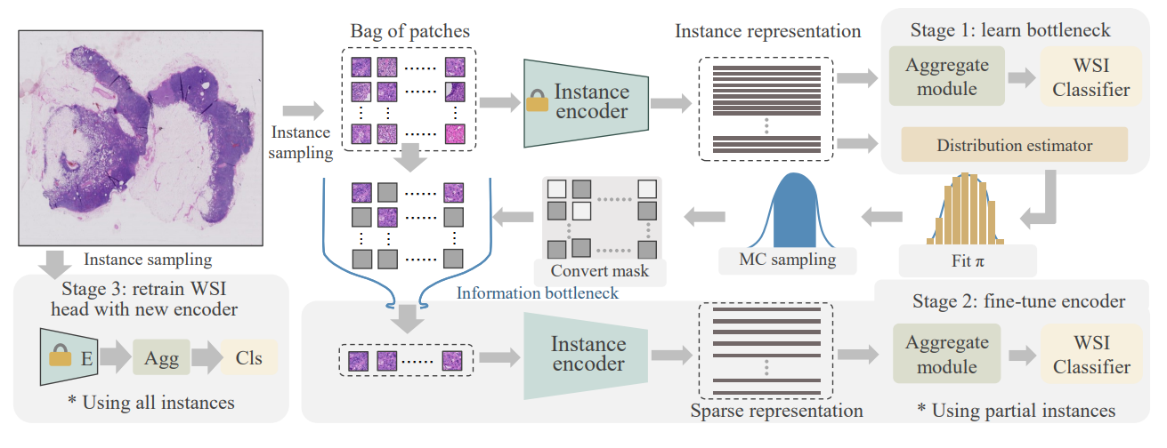
WSI-MIL Architecture
3
Figure 3: Workflow of WSI-MIL task-specific fine-tuning
自强不息 厚德载物
Notes:
1) Initialize the backbone with pretrained parameters and set frozen, then learn the IB module to generate instance masks.
2) fix the mask to distill a sparse bag, then fine-tune the WSI head and patch the backbone end-2-end.
3) utilize all fine-tuned instance features within a bag and train the WSI-MIL classifier head.

Slide 5



WSI-MIL Architecture
3
Goal make WSI level Prediction
Due to its extremely high resolution, X is patched into a huge bag of small instances X = {x1, ..., Xa where N is the number of instance.
latent labels of instances are unknown under the WSI-level supervision
Optimize the compression of input data
Reducing the dimensionality of the representation space or converting input data into a sparse format to filter out task-irrelevant instances.
Bernoulli distribution to define a binary mask, the method decomposes the KL divergence term in MIL, facilitating efficient learning and decision-making based on sparse sub-bags of instances.
Objective Function
utilize all fine-tuned instance features within a bag and train the WSI-MIL classifier head
where I(·, ·) indicates the Mutual Information (MI) and β is a Lagrange multiplier controlling the trade-off between the information that the representation variable Z shares with the label Y and its shares with input X.
Figure 3: Workflow of WSI-MIL task-specific fine-tuning
自强不息 厚德载物
Notes:
Since all latent labels of instances yˆi are unknown under the WSI-level supervision, conventional approaches convert this problem into a MIL formulation in the following two steps:
Processing images into feature representations
Aggregating all patches’ features within a slide and producing the slide-level prediction
IB: Information compression role to intervene in DNN’s training
Since the computation of MI is intractable during the training of the neural networks, to maximize IB objective can be transferred to minimize a variational bound.
Learn MIL Sparsity via Variational Bound of IB
To trade off the dilemma of computational limitation and task-specific representation learning via end-to-end backpropagation, we propose to utilize the IB module to filter most task-irrelevant instances for task-specific fine-tuning.

Slide 6
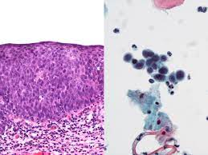
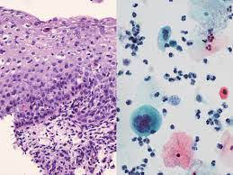
Experiments
3
Dataset Details
The method is tested on five datasets, including both histopathology and cytopathology images, such as Camelyon-16, TCGA-BRCA, and an internal cytopathology dataset for cervical cancer screening.
Generalization testing: Beyond standard datasets, the method's adaptability is assessed on Camelyon-16-C and Camelyon-17, simulating real-world challenges in pathological diagnosis.
Pre-processing approach: Pre-processing involves standard techniques like HSV, Blur, Thresholding, and Contours to localize tissue regions in WSIs, followed by extracting non-overlapping patches of size 256 × 256 at 20X magnification.
自强不息 厚德载物
Central South University

Slide 7
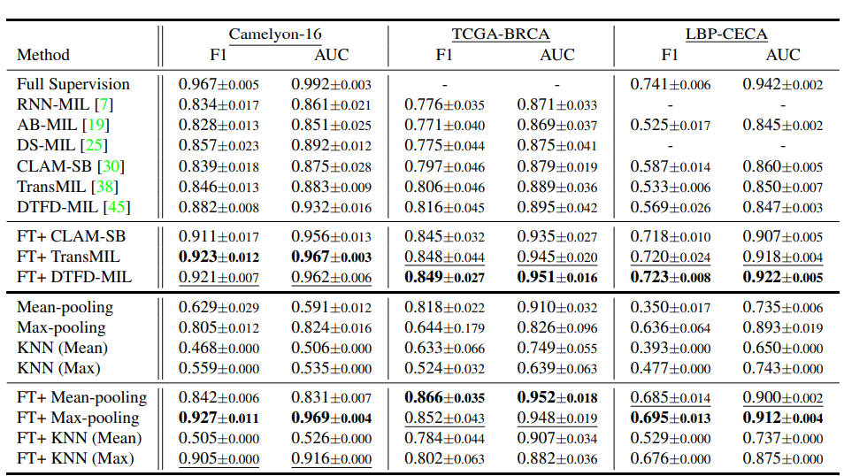
Pretraining and Fine-tuning.
3
自强不息 厚德载物
Central South University
Notes:
Table 1. Slide-Level Classification by using the IN-1K pre-trained backbone or the proposed fine-tuned (FT) in three datasets. Top Rows. Different MIL architectures are compared to select the top 3 SOTA methods to validate the transfer learning performance using the IN-1K pre-trained backbone or the FT. Bottom Rows. The competition of various traditional aggregation and feature evaluation methods by using pre-trained IN-1K or the FT.

Slide 8
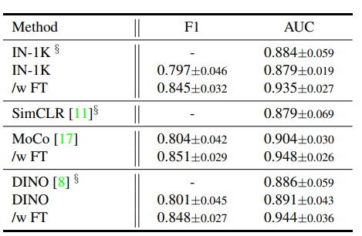
Combination of SSL and Fine-tuning
3
自强不息 厚德载物
Central South University
Notes:
Table 2. Combination of SSL and Fine-tuning. We compare SSLs with IN-1K and their further improvement via fine-tuning (FT) on TCGA-BRCA. The symbol § indicates the result released in previous publication

Slide 9
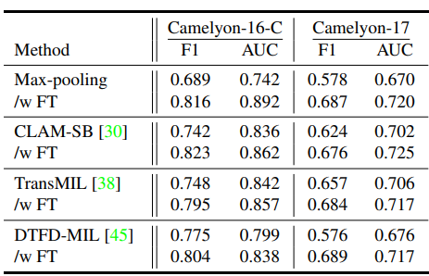
Generalization on Domain Shift
3
自强不息 厚德载物
Central South University
Notes:
Table 3. Generalization on Domain Shift. The generalization ability of all methods is compared between fine-tuning(FT) and IN-1K features on two datasets with domain shift. Camelyon-16-C and Camelyon-17 are synthetic and real corruptions respectively.

Slide 10
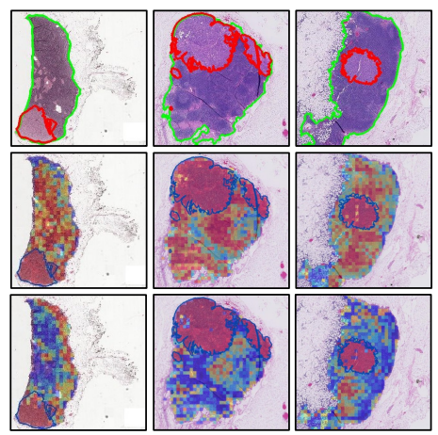
Interpretability and Visualization
3
Figure 4: Heatmap comparison between pretraining and FT. The first row shows the full annotations, where red contours denote the tumor area and green contours filter the nonsense background. The second and third row shows the WSI attention map on pretraining and FT features respectively.
Figure 4: Heatmap comparison between pretraining and FT.
自强不息 厚德载物
Central South University
Notes:
As shown in Figure 4, attention scores from CLAM-SB [30] were visualized as a heatmap to determine the ROI and interpret the important morphology used for diagnosis. The model focuses more on tumors with FT features.

Slide 11
Conclusion
4
Significant improvements in accuracy and generalization: The proposed method outperforms previous works in weakly-supervised pathology whole slide image (WSI) classification, achieving notable advancements in both accuracy and generalization.
Utilization of Self-supervised Learning (SSL) pretraining: The method leverages SSL pretraining combined with fine-tuning based on the Information Bottleneck theory to extract task-specific representations from SSL or ImageNet pretrained models.
Efficient WSI fine-tuning framework: The method employs an efficient WSI fine-tuning framework that identifies minimal sufficient statistics of WSIs and facilitates fine-tuning of the backbone into task-specific representations using weak labels.
自强不息 厚德载物
Central South University

Slide 12
THANKS FOR ALL
Task-specific Fine-tuning via Variational Information Bottleneck for Weakly-supervised Pathology Whole Slide Image Classification
Honglin Li , Chenglu Zhu , Yunlong Zhang , Yuxuan Sun , Zhongyi Shui , Wenwei Kuang , Sunyi Zheng, Lin Yang*
Published in: Conference on Computer Vision and Pattern Recognition (CVPR)（2023）
Saif Ur Rehman Khan

